Slide 1



State Level Financial Aid Training
December 10, 2025

Slide 2
Agenda
09:00 am State Financial Aid Updates
09:10 am State Aid Appeals
09:20 am WV Higher Education Grant
09:50 am Promise Scholarship
10:30 am WV Stem Scholarship & Underwood Smith
Teaching Scholars Program
10:40 am Nursing Scholarship
10:50 am HEAPS Workforce &Heaps Part time
11:00 am STAND Program
11:15 am WV Invests Grant

Slide 3
State Aid Update
Institutions enter budget information directly into FAMS for 26-27 available April 1 and need updated prior to May 15
  Public schools – we will update tuition based upon what is submitted to finance for approval
  Private schools – send us an email with amount of tuition/fees for 26-27
Redesign of state financial aid
Redesign of FAMS
Make sure FAMS users are up to date and when someone leaves the FAMS administrator on the campus is locking the account or having our office lock the account.

Slide 4
State Aid Update
Have 26-27 award information for Promise and WV Higher Education Grant by February 27
State Aid Reviews have started on a 3-year cycle
Preliminary invoices for spring will begin in December where we will balance spring
Once your roster is updated for spring and reconciled for fall, please request an invoice by March 15

Slide 5
Legislative Update
Needs updated prior to presentation of what passes
HB 2773 – Legislative rules
HB 2166 – Behavioral Health Workforce Education
HB 2190 – Potomac State Learn and Earn
HB 3024 – Guaranteed course transfer
HB 3150 – Health Science and Medical Student Loan

Slide 6
Invoices/Closing
Closing[Search] to request an invoice or a closing
  Make sure contacts on closing page are updated before requesting the closing for each program
  Once you are completely reconciled and all changes have been completed, then request the closing. Once you request the closing, you will immediately have read-only access for that program and any changes after you have requested the closing will be accounted for in the closing in October.
  Closing statements will come through noreply@airslate.com
  June 15 closing deadline HEGP, Invests, Promise, STEM, USTP, and ChooseWV
  September 1 deadline HEAPS PT, HEAPS WF, Summer Promise
  Can request a closing starting May 1 for 25-26 in FAMS once reconciled

Slide 7
HEPC Address Update
2001 Union Carbide Drive Building 2000 South Charleston, WV, 25303
Only return funds as part of a closing statement. If you need to return funds for a state aid program, please include a copy of the closing statement
  WV Higher Education Policy Commission, PO Box 40212, Charleston, WV 25364.

Slide 8
Degree Pursuant Coursework Appeals
(CPOS)
Appeals processed in airSlate
  Emails will come from WVColleges via airSlate
  Eligibility: Appeals are for state aid recipients who do not have enough degree-pursuant courses available during the semester or academic year to qualify for an award or renewal.
Important Notes:
  Prescreen applicants before sharing the link.
  Do not post the link publicly.
  Ensure students submit the correct year. If they need to apply for a prior year, use the old link.
  Automated processing: Once an appeal is submitted, it will move to the next step as completed. Only fields highlighted in the form are editable.
  The form is no longer two separate documents, so email verification is not required.
  Ensure a school email is used and it is correct. The form and email will provide instructions for the student, advisor, and financial aid contact.
Notes:
CPOS course program of study

Slide 9
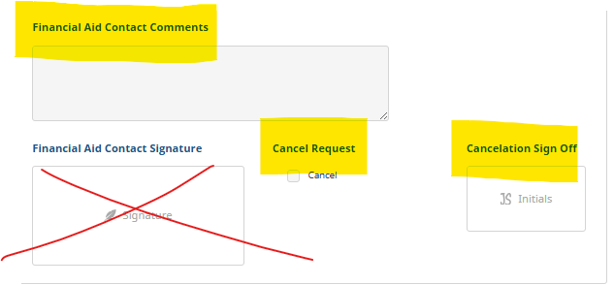
Degree Pursuant Coursework Appeals
(CPOS)
Updates
  The FA Contact can cancel the form by checking the Cancel Request Box, initialing Cancelation Sign Off, and submitting a reason for cancelation in the FA comment section.
Notes:
CPOS course program of study

Slide 10
Degree Pursuant Coursework Appeals
Process for DPCW appeals
1. Student Access to Form
The institution’s financial aid office provides the student with access to the appeal form.
Student completes the form using their school email address.
2. Student Submission
After submission, the form is automatically routed to the institution’s Financial Aid (FA) Contact.
3. Financial Aid Contact Review
The FA Contact enters the Academic Advisor’s name and email.
Advisor information can be updated, if needed.
4. Academic Advisor Review
The Academic Advisor reviews the request and provides a required sign-off.
Advisor must include:
  A brief explanation of why the student cannot take sufficient degree-pursuant courses.
  The total number of credit hours the student is eligible to take for the specified term(s).

Slide 11
Degree Pursuant Coursework Appeals
Process continued
5. Financial Aid Office Decision
The appeal returns to the FA Office for approval or denial.
Before approving, confirm that:
  The student is a current recipient and eligible for renewal.
  The student’s FAMS record shows eligibility.
  Part-time enrollment is not chosen due to personal circumstances (e.g., work schedule, athletics, life conflicts).
6. HEPC Final Review
Approved appeals are sent to HEPC for final approval.
7. Notifications
The student receives an approval or denial email for each individual program.
A final decision copy is also emailed to the institution’s FA Contact.

Slide 12
State Aid Appeals
Appeal to Waive Full-Time Enrollment Requirement
Who should appeal: Current recipients who cannot register full time in degree-pursuant courses.
Programs appeal can be used for:
  WV STEM
  Underwood-Smith Teaching Scholars
  WV Promise Scholarship
  WV Higher Education Grant
Confirm eligibility before referring student to appeal
Where to send students: cfwv.com/dpcappeal
Promise recipients in their final year do not need to submit this appeal.

Slide 13
State Aid Appeals
Promise Scholarship Credit Hour Requirement Appeal
Who should appeal: Current recipients who can be full time but will not meet 15 or 30 credit hour req in the year.
Program appeal can be used for:
  WV Promise Scholarship
Confirm eligibility before referring student to appeal
Where to send students: cfwv.com/promiseappeal
Promise recipients in their final academic year of eligibility do not need to submit this appeal.
  Due to graduation or 8th semesters of usage.

Slide 14
State Aid Appeals
Appeal to Waive Half-Time Enrollment Requirement
Who should appeal: Students who appear eligible and cannot register at least part time in degree-pursuant courses.
Program appeal can be used for:
  WV Invests Grant
Where to send students: cfwv.com/investsappeal
May appeal before or after application is certified eligible.

Slide 15
Degree Pursuant Coursework Awards
Prorated Awards
Proration for WV STEM, Underwood-Smith, and WV Higher Education Grant (Our office updates FAMS for these programs)
  75% = Three-quarters time
  50% = Half-time
  25% = Less than half-time
Institution Financial Aid Office Responsibilities
  Adjust Promise and WV Invests award amounts in FAMS based on actual Tuition & Fees.

Slide 16
Degree Pursuant Coursework Awards
How to Identify Program Approvals in FAMS
  WVHEG, WV STEM, Underwood-Smith → Look for these adjustment codes:
    Waiver Half-Time
    Waiver Three-Quarter
    Other Adjustable
  Promise → Check the Details screen under the Promise Grace field:
    “W” = DPCW Part-Time Waiver
    “C” = Credit Hour Appeal

Slide 17
State Aid Appeals
Appeals for Nonrenewal & Initial Eligibility
Send all appeals for nonrenewal and initial eligibility directly to the program email.
Promise Nonrenewal Appeals
  Must first go through the institution’s internal appeals process.
  If the institution denies the appeal, the student may request a secondary review by our office.
Residency Appeals
  Can be submitted through the school or directly to our office.
  Residency information and forms are available at:
  cfwv.com/residency
  For a second-level appeal, students will be required to upload approved documentation.

Slide 18
State Aid Appeals
Who to Contact for Each Appeal
Appeal to Waive Full-Time Enrollment Requirement
  Tana Pendell
WIN Appeal for Waiver
  Sarah Griffith
Promise Scholarship Credit Hour Waiver Appeal
  Sarah Musgrave
Residency Appeals
  Matthew Walker
Appeal for nonrenewal or initial eligibility
  Program managers
  Students should email the program directly or call the office for assistance.

Slide 19

Questions ?

Slide 20

BREAK
will resume at 9:20 am

Slide 21

  Deadline for 2026-27 Higher Education Grant
  April 15, 2026

Slide 22
Eligibility
  Attending an eligible institution;
  Must be full-time undergraduate in payment period (12 credits);
  SAI under cut-off determined by Advisory Board;
  Cannot exceed need or cost of attendance;
  Be U.S. citizen;
  Have high school diploma or GED/TASC
  Meet SAP
  Student must complete verification if selected on ISIR

Slide 23
Residency
  Resident for one year immediately preceding date of filing the FAFSA;
  If dependent student, then parents must be WV residents as well;
    If student has one parent in WV and another parent outside WV; to be grant eligible, the parent in WV must be on the FAFSA
    However, still must follow the guidance on FAFSA that parent that student lives with most should be the parent information on the FAFSA
  Intentions of being in WV other than attending college;
  West Virginia resident who receives grant disbursement and then moves outside West Virginia can keep funds already disbursed but is not eligible for future disbursements

Slide 24
Residency
  If institution has conflicting information regarding residency, then institution must either
    Resolve the discrepancy
    Notify HEPC so we can resolve discrepancy
    Cancel the award as “other adjustable” and leave note on FAMS as to why grant was canceled
  Conflicting information may be
    Just graduated from an out-of-state high school
    Out-of-state driver’s license
    Charging student out-of-state tuition
    Has an out-of-state address on institution’s records

Slide 25
Academic Eligibility for Initial Award
  If earned college credit, then must have 2.0 cum gpa;
  If 5 years or more since receiving a high school diploma or passing a HS equivalency exam, then must meet admissions requirements;
  If less than 5 years, then a passing score on a HS equivalency exam or 2.0 high school GPA or higher.

Slide 26
Academic Requirements for Renewal
  Credit hours
    1 semester/quarter (12 credits)
    2 semesters/quarters (24 credits)
    3 quarters (36 credits)
    May include summer credits and grades earned in term right before award year
  Must have at least a 2.0 cumulative gpa by the end of the summer term to be renewed for the following year;
  Academic Eligibility only checked once a year.
Notes:
The credit hour requirement for renewal is only required of a student who has received grant disbursements previously
If a student has never received a disbursement of the Higher Education Grant, they are not required to have met the credit hours completed previously in order to be eligible

Slide 27
Student is enrolled full-time 2025-26 and receives HEGP for both semesters. Based upon credit hours completed the student is eligible for 2026-27
Fall 2025
9 completed hours
Spring 2026
15 completed hours
The student is eligible for
26-27

Slide 28
Student is enrolled full-time 2025-26 and receives HEGP for all 3 quarters. Based upon credit hours completed the student is eligible for 2026-27
Fall 2025
8 completed hours
Spring 2026
16 completed hours
The student is eligible for
26-27
Winter 2025 12 completed hours

Slide 29
If a grant recipient’s SAI changes, the grant award will be adjusted based upon the most recent ISIR transaction
Institutions must watch SAI changes if it results in changes to the award amount
If an SAI increases above the SAI cutoff, then the award will be revoked
If an SAI is above the SAI cutoff, then drops below the SAI cutoff, the student will have to wait for the next award cycle to be awarded

Slide 30
Priority of Awards
Federal student financial aid grant and scholarship programs utilized first;
Resources available through other state aid programs utilized second, including Promise;
Other grants and scholarships including institutional aid;
Then Higher Education Grant can be used if financial need remains.

Slide 31
If student withdraws, college must abide by refund policy for calculating amount to be returned to HEPC.
If student is not receiving federal aid, then institution uses the Commission’s rule for issuing refunds
If student is receiving Title IV aid, then institution uses R2T4 for calculating refund
Notes:
When applying R2T4 to calculate refund:
Take the number of days student attended the term divided by the total number of days in the term to determine percentage
Take percentage of days attended in term times the amount of state grant funds for the term to determine how much student has earned and how much to return

Slide 32
When applying R2T4 to calculate refund:
  Student attends 25 days in term
  There are 100 days in the term
  Student attended 25% of term
  Grant payment of $1,650 for the term is multiplied by 25%
  $413 is awarded to the student and $1,237 is returned to HEGP
  Student award in FAMS should be $413 with an adjusted code of “withdrew”

Slide 33
If student who withdraws attended more than 60% of the term, then student can keep 100%;
When providing counseling, best practices is to inform student that their future eligibility may be impacted by not completing the appropriate amount of credits.

Slide 34
WV Higher Education Grant Progress Waiver
  Waiver of credit hours
  Only eligible if the student withdraws from all courses in a semester because of extenuating circumstances.
  Waiver requests sent by institution and submitted to HEPC

Slide 35
Disbursements
  Semester Schools
    Even disbursements between fall and spring
      50% fall semester, 50% spring semester
    No disbursements in the summer
  Quarter Schools
    Even disbursements between fall, winter, and spring
      33% fall quarter, 33% winter quarter, 34% spring quarter
    No disbursements in the summer

Slide 36
Only receive grant for 8 semesters;
Not eligible if student has a bachelor’s degree or not deemed an undergraduate by the institution;
Follow federal definition if student has met the requirements for a bachelor's degree but has not accepted the degree, student is still not eligible (Student Aid Handbook, Volume 1, Chapter 6, page 1-67).

Slide 37
Student cannot receive state grant and HEAPS during same payment period
  (includes both part-time HEAPS and workforce HEAPS).
Can only receive grant at 1 institution per payment period.
  Especially watch when student transfers between a semester school and a quarter school

Slide 38
Students selected for federal verification, must complete verification in order to be eligible to receive payment
If the student never completes verification, then the student is not eligible for the grant award
Students must meet the SAP policy of the institution
Students who are not eligible for federal aid because of SAP are not eligible for HEGP

Slide 39
Initial award cycle will be in May
Award cycles after Nov. 1 will be for spring only;
Final reconciliation completed by June 15;
Reviews (audits) will be conducted

Slide 40
Semester schools rosters updated by October 15 for fall and March 15 for spring
Quarter schools rosters updated at the beginning of fall, winter, and spring terms
Once rosters have been reconciled, request invoice in FAMS under Closing.

Slide 41
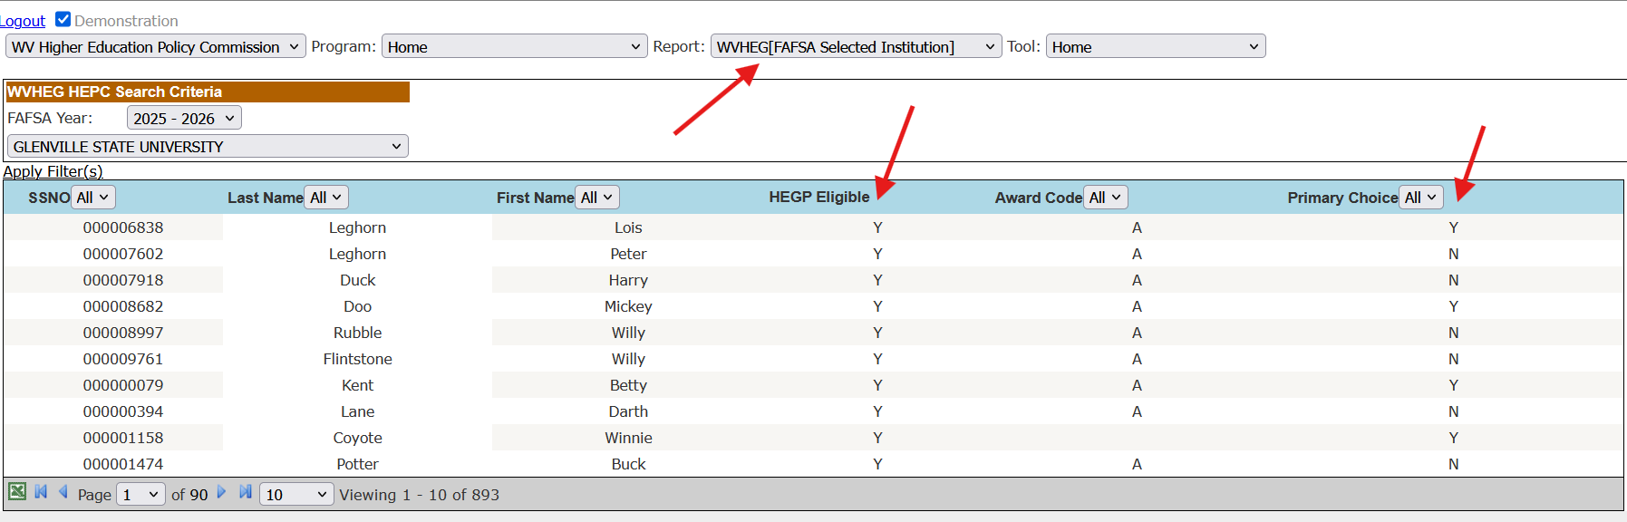
FAMS

Slide 42
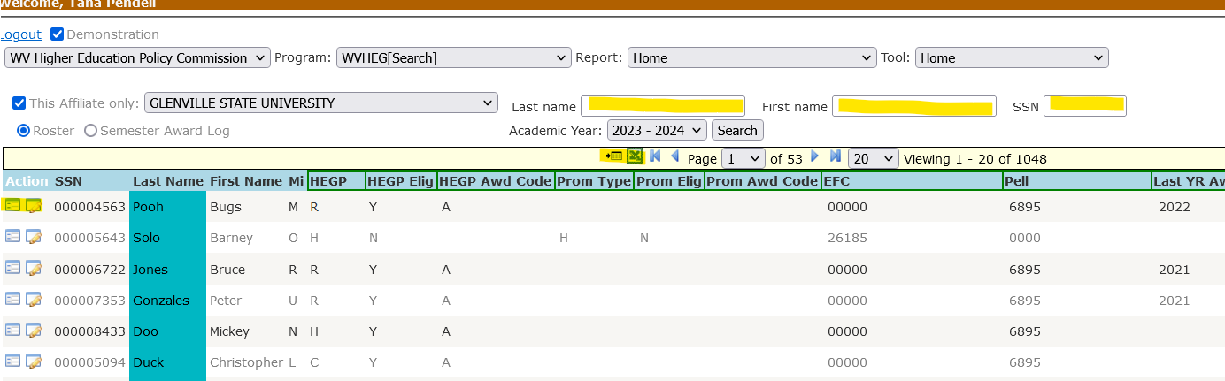
FAMS

Slide 43
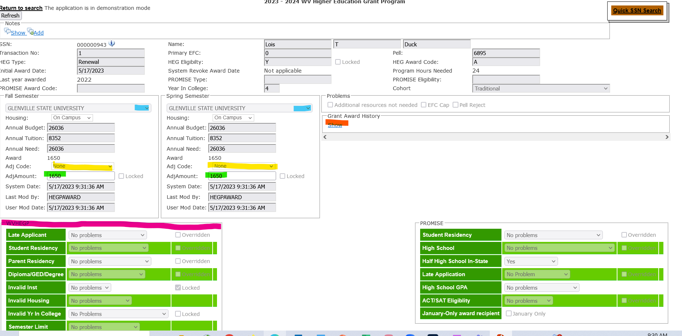
FAMS

Slide 44
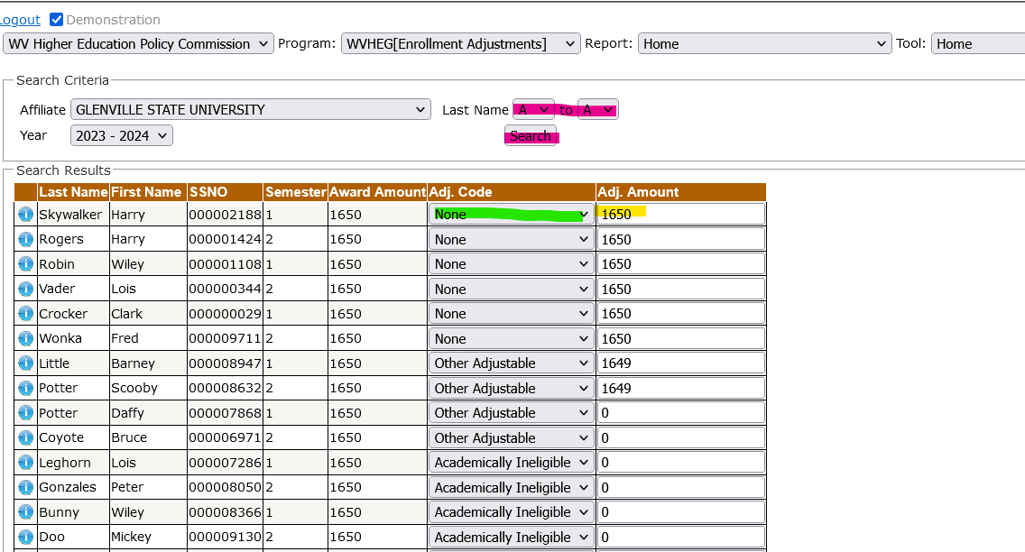
FAMS

Slide 45
Questions ?

Slide 46
BREAK
will resume at 9:50

Slide 47


Slide 48

Academic eligibility standards for the 2026
  3.0 overall and 3.0 core high school grade point average
  Core course requirements (4 English, 4 Math, 4 Social Studies, 3 Science)
  21 ACT Composite with a minimum 19 in each subject area OR
  1080 SAT Total Score with minimum of 510 EBRW and 510 Math
  Super scoring permitted

Slide 49
Final test dates to establish scholarship eligibility for 2026 July 2026 for the ACT; June 2026 for the SAT
2026-2027 Free Application for Federal Student Aid (FAFSA) must be filed by March 1, 2026, at studentaid.gov/fafsa
Promise Scholarship application must be completed on the WVSAM system by March 1, 2026, at cfwv.com/promise

Slide 50
Late Applicants
Students who do not apply by March 1, can still apply and be considered for Promise but would not be awarded until spring term. Late awards are contingent upon the availability of funds.
Additional Eligibility Requirements
Graduate from a WV Public, Private High School, homeschool program
  Micro school, learning pod, charter school are considered eligible high schools.
Must complete half of their graduation requirements at a WV High School
  Exception for eligible commuters, military dependents.
Student and Parent must be a WV resident at least 12 months before application deadline

Slide 51
Additional Eligibility Requirements
Must apply within two years of graduation from high school unless entered U.S. armed forces.
Students already enrolled at a higher education institution are not eligible to apply.
  May be able to apply as a late applicant for the previous year.
Alternative Education Programs
  Option pathway graduates
    Must meet all other eligibility requirements to qualify, including GPA and test score requirements.
  Mountaineer Challenge Academy
  High School Equivalency Only
    Must Appeal to qualify

Slide 52

Application
Apply, Edit, or Check the status of Promise Scholarship application on the WVSAM system
Students will create an account with their information including username (email), verify their email and create a password. They can then log in to complete the State financial aid applications
Application Status page shows once the application is complete. Also, confirmation email is sent with next steps.

Slide 53
Promise Awards
Awards Cover Tuition and Mandatory Fees at eligible institution up $5,500 per year.
  $2,750 max per semester
  Tuition & Mandatory Fees only
Limit of 4 semesters - associate degree program
Limit of 8 semester – bachelor’s degree program
  Transfer from two-year to four-year or four-year to two-year, previous semesters of utilization do count towards the max.

Slide 54
Promise Awards Continued…
Community service is highly encouraged
Students have six years after being awarded to utilize their Promise eligibility (military service exception)

Slide 55
Promise Awards
Once a student qualifies in our system and we have all information necessary, they will show up on the FAFSA Selected Institution Report in FAMS, under Reports.
  If your institution is listed as a school on the FAFSA
  Reports indicates if listed as primary school on the FAFSA
Student can lose eligibility if final grades fall below the requirements.
Can see ineligible reasons on WVHEG screen if the student has filed a FAFSA.

Slide 56
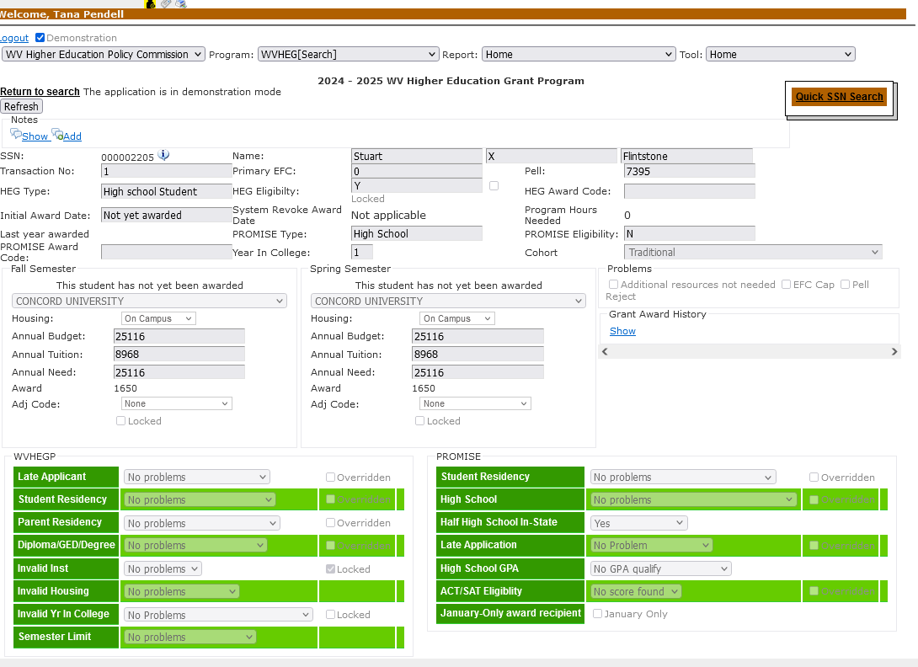

Slide 57
Promise Renewal Requirements
Maintain a 2.75 overall grade point average on a 4.0 scale EACH YEAR.
Overall gpa includes all college level courses a student has taken
Earn a minimum of 30 credit hours in an academic year for a student who receives a two-semester award in an academic year.
  If a student receives a single-semester award, the student must complete and earn a minimum of 15 credit hours in the academic year.
Academic year includes fall, following spring, and following summer terms
  Example 2025-2026 includes fall 2025, spring 2026, and summer 2026

Slide 58
Promise Renewal Requirements
Credit Hour Requirement
  CLEP credits may be used to meet credit hour requirements.
  Repeated Coursework limitation has been removed and both credits can be counted if credits are earned.
    GPA would use institutional grading policy.
Not required to reapply or file FAFSA for renewal.

Slide 59
Second Chance Promise Renewal
Recipients who lose the scholarship for not meeting renewal may petition to have the scholarship reinstated after they obtain the requirements.
  May now make up the requirements to qualify and request once they achieve the requirements.
  Limited to one petition. If they lose the scholarship again, cannot utilize the petition process.
  Each term the recipient enrolls to achieve requirements will count as semesters of utilization.
    If they are not enrolled, it will not count against them but will still be limited to the six-year window for utilization.
  Can be reinstated in the spring term, if the student achieves renewal with fall.
  Student will need to submit request through Airslate to have their status reviewed by school to have Promise reinstated.
  Started with 2023-2024 to 2024-2025 renewal. Those who lost prior to this year cannot utilize this process.
  This does not replace the appeals process for students with extenuating circumstances.

Slide 60
Two semester award - Student received Promise in
2024-25 for both terms. Is the student eligible based
on credit hours for 2025-2026?
Student
A
Spring 2025
16 completed hours
Is the student eligible for 2025-26?
Yes
Fall 2024
14 completed hours
Student
B
Fall 2024
8 completed hours
Is the student eligible for
2025-26?
No
Spring 2025
15 completed hours
Summer 2024
7 completed hours

Slide 61
One semester award - Student received Promise in 2024-25 for one term. Is the student eligible based on credit hours for 2025-2026?
Student
C
Spring 2025
2 completed hours
Is the student eligible for
2025-26?
Yes
Fall 2024
14 completed hours
Student
D
Spring 2025
0 completed hours
Is the student eligible for
2025-26?
Yes
Summer 2025
3 completed hours
Fall 2024
12 of 15 completed hours

Slide 62
Second Chance Promise Renewal Example:
Fall 2024
12 completed hours
Spring 2025
12 completed hours
Fall 2025
12 completed
hours
Does student meet renewal for 2025-26?
No
Spring 2026
Second Chance Promise Renewal Request
Fall 2025 counts as a semester of utilization
Reinstate Spring 2026

Slide 63
Second Chance Promise Renewal
Information available in award letter, not enrolled emails and reminders sent each semester by HEPC.
Please actively seek out students who should request this, review and communicate
  Doesn’t have to be immediately after end of semester
  February/March after fall term
  June after spring term

Slide 64
Promise Recipients who attend an Out of State College
Promise cannot be taken out of state.
Students may enroll at an ineligible institution for up to 1 academic year after being awarded and regain eligibility.
Must enroll at eligible institution and meets renewal eligibility criteria by the following fall term.
  Ex: 2025 recipient must be enrolled by fall 2026
  HEPC Reviews transcript for out of state students if out of state for the full year.
    If one semester, school would review after one year.

Slide 65
Summer Promise Scholarship
Current Promise recipients can apply for summer awards
Counts as a semester of utilization
Must meet academic requirements at the end of the spring semester preceding the summer term to qualify.
Must submit a summer Promise application on cfwv.com/summerpromise
If a student is attending multiple institutions or a different institution than home in the summer, the home institution will have to have a consortium agreement on file and home institution will update the student status in FAMS for them to qualify.
Max 2025 Summer Award Amount will be $2750 for tuition and mandatory fees
Application becomes Available March 15
  Priority Deadline May 15
  Final Deadline June 15

Slide 66
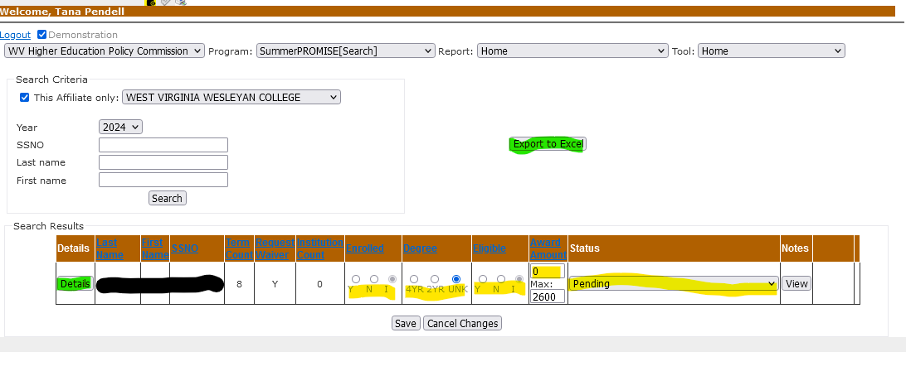
Summer Promise Scholarship in FAMS

Slide 67
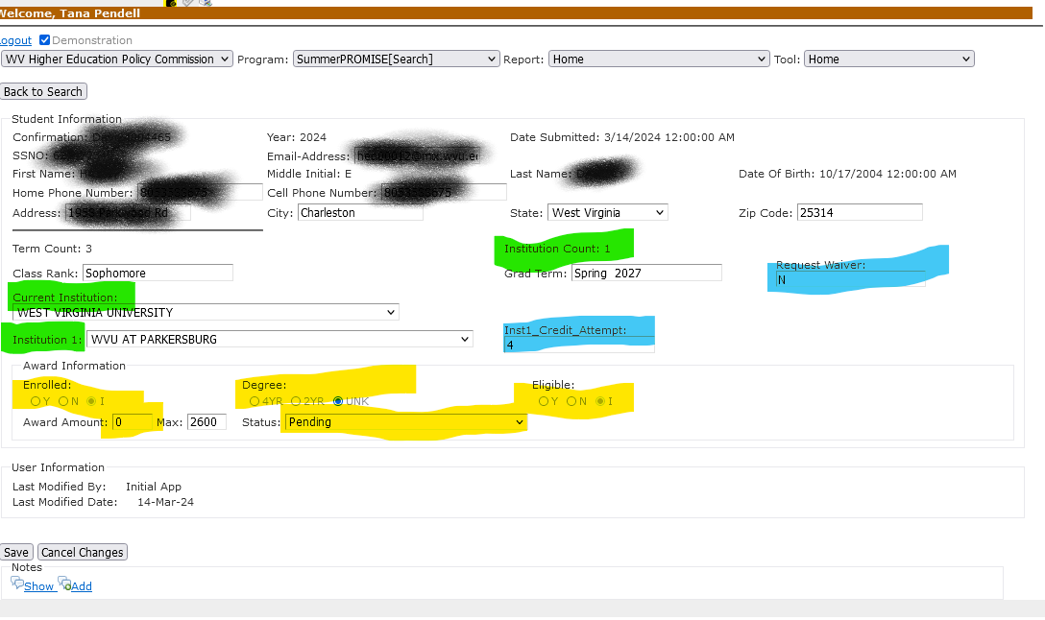
Summer Promise Scholarship in FAMS

Slide 68
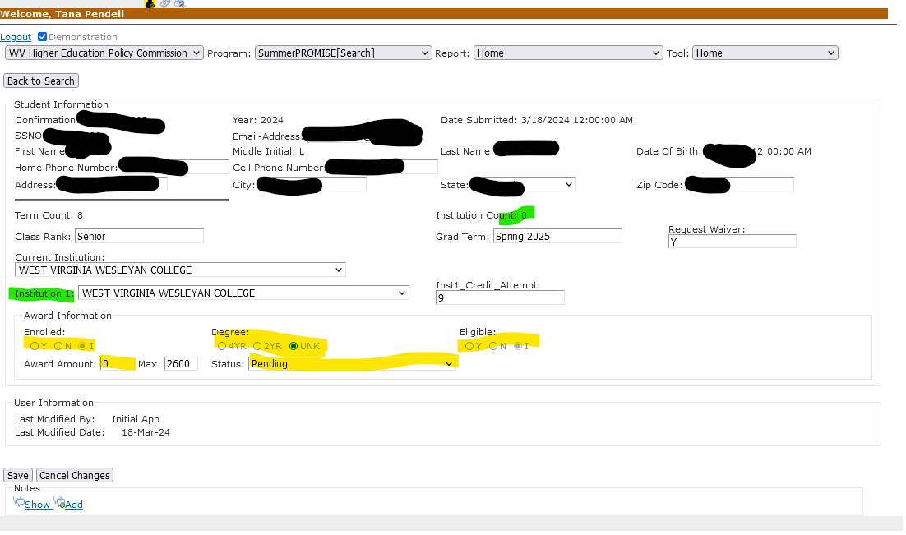
Summer Promise Scholarship in FAMS

Slide 69
Promise recipients must maintain continuous enrollment as a full-time student or have an approved leave of absence or appeal to remain eligible, if completely withdraw during a term.
  Except during last academic year of eligibility
When a student withdraws from all courses, institution must follow Commission’s rule on issuing refunds if student is not receiving Title IV aid
  If the student is receiving Title IV aid, then use R2T4 using same guidance as WVHEG
A student who withdraws cannot petition for Second Chance Promise Renewal; they must appeal.

Slide 70
Institutional Deferments
  Military
  Medical
  Family Bereavement
  Study Abroad
  Internships
  Other Aid Used
If approved by institution and student did receive Promise funds during the semester, you must notify us so we can update a student status to Promise Grace for the term.
  Promise Grace indicates a student receives a deferment but counts as a semester or utilization if they did use funds.
All other deferments must be approved through WVHEPC
  Email Promise@wvhepc.edu to request a deferment

Slide 71
Appeals for Non-Renewal or Withdraw
  Students appeal to the institution first;
  If appeal is denied by institution, then student may appeal to HEPC within 15 days;
  If appeal denied by HEPC, then student may appeal to Vice Chancellor for Administration within 15 days.
  Ruling of Vice Chancellor for Administration is final.
Appeals for initial eligibility
  Students appeal to HEPC first;
  If appeal denied by HEPC, then student may appeal to Vice Chancellor for Administration.

Slide 72
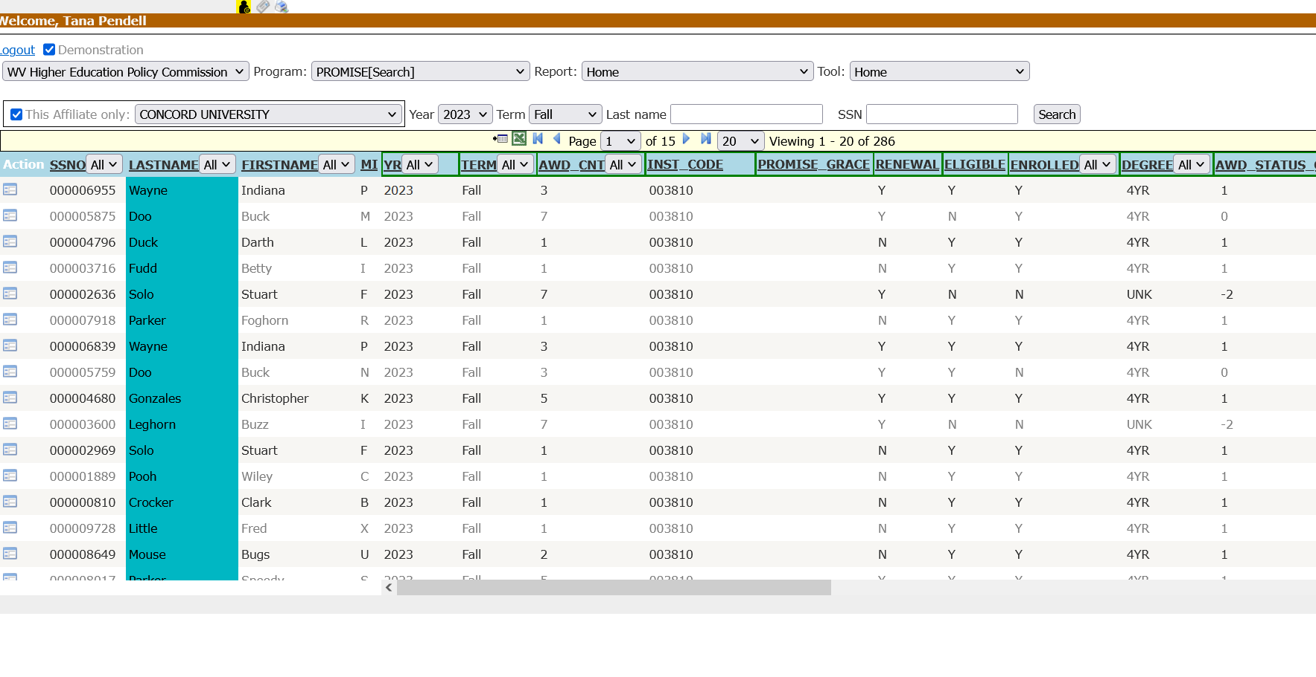
FAMS Updates
Details page, can search, sort, filter.
Click Red Arrow for details for individual student

Slide 73
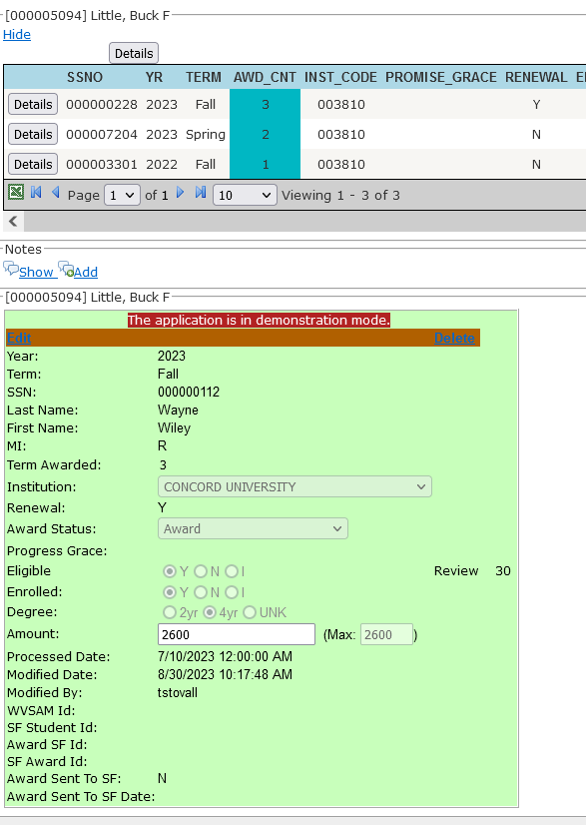
FAMS Updates
Details page.
Click Details button to get a term
Click Edit to open the record for updates.

Slide 74
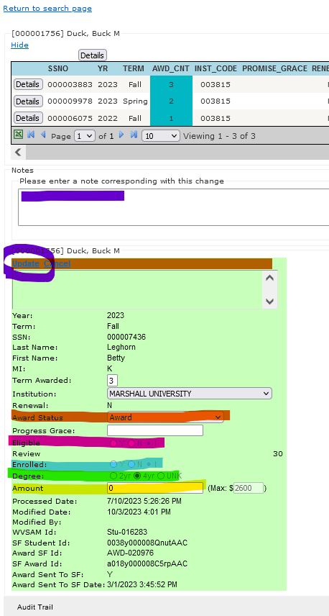
FAMS Updates
Updating a record.
You must update all fields to be able to save
-Award Status Code (Award, Deny, or Defer)
-Eligibility Status (Academic Renewal Status)
-Enrollment Status (Enrolled full time)
-Degree (2yr or 4yr)
-Amount of Tuition and Mandatory Fees (Cannot exceed Max)
-Leave a note
-Click Update to save

Slide 75
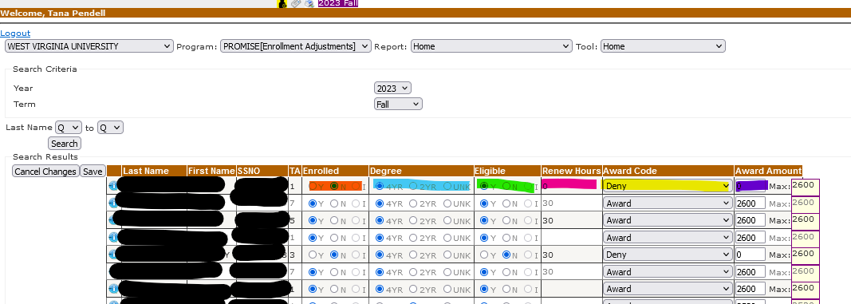
FAMS Updates
Updating a record on Enrollment Adjustment Screen.
-Award Status Code (Award, Deny, or Defer)
-Eligibility Status (Academic Renewal Status)
-Enrollment Status (Enrolled full time)
-Degree (2yr or 4yr)
-Amount of Tuition and Mandatory Fees (Cannot exceed Max)
MUST CLICK SAVE. This screen will time out if you don’t click save periodically

Slide 76
FAMS Updates
Updates due by October 15 in fall term,
March 15 in the spring term.
  Also, Batch upload process available.
  All records must be updated for us to process second invoices.
  All records at all institutions must be updated for us to send various communication AND do the “rollover” to the next semester.

Slide 77
Questions?

Slide 78
BREAK
will resume at 10:20 am

Slide 79


Slide 80
Applications open on October 1st each year
  Students apply by March 1
  Returning students MUST reapply each year!
Awarding Order:
  Returning Applicants
  College Applicants
  High School (formula with GPA & Test Scores)
    Will award as many high school students as funding allows.
Students receive an award of $3,000
Student must sign a promissory note through our servicer ECSI to be eligible.
Students must work in a STEM occupation in WV for 1 year for each year the award is received. Otherwise, the scholarship will turn into a loan.
  Occupations within healthcare are NOT eligible for service requirement.
Students will receive a disbursement notification each semester.

Slide 81
Before March 15th each year schools should update in FAMS.
  College and Returning Applications:
    Overall GPA
    Satisfactory Progress
    Field of Study/Major
    Cost of Attendance
  High School Applications
    Field of Study/Major
    High school grades and test scores will be received automatically for WV students
Eligible Students:
  Eligible Flag (Y)
  Awarded (Y)
  Prom Note (Y)

Slide 82
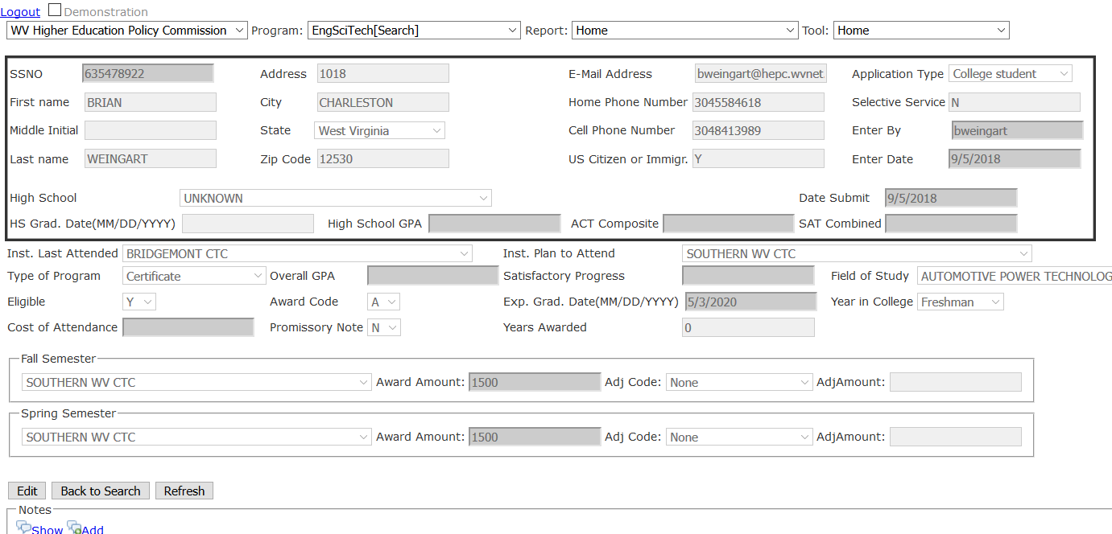











Green: eligible fields
Yellow: need updated

Slide 83
Questions?

Slide 84


Slide 85

Only high school seniors or those who have not attended college previously can apply for a first-time award
3 step application process
  Round 1- initial application
  Round 2- community service, extracurricular activities, and essay
  Round 3- video of why they want to be a WV teacher
New cohort selected mid March
Students receive award of $10,000
Student agrees to teach in critical need field (math, science, special education, and elementary education) in WV for 5 years. Otherwise, the scholarship becomes a loan.

Slide 86

Renewal students need to have a 3.0 cumulative gpa at end of either spring or summer to renew for the following year
Students do not have to reapply
At end of spring term, FAMS needs updated for renewal students.
  If a student is not eligible at end of spring or summer, they can regain eligibility at such time their cumulative gpa is above 3.0

Slide 87

After new cohort is selected in March, we will email schools and let them know who is eligible and to update FAMS.
  Eligible Students:
    Eligible Flag (Y)
    Awarded (Y)
    Prom Note (Y)
  FAMS Update:
    GPA
    Expected Graduation Date
    Cost of Attendance
Renewal students will be imported into FAMS May 1st. FAMS will need updated:
  Check field of study- student must still be enrolled in math, science special education or elementary education teaching program
  GPA
  Expected Graduation Date
  Cost of Attendance
  SAP
Student must sign a promissory note each year through our servicer ECSI to be eligible
Students will receive a disbursement notification each semester.

Slide 88
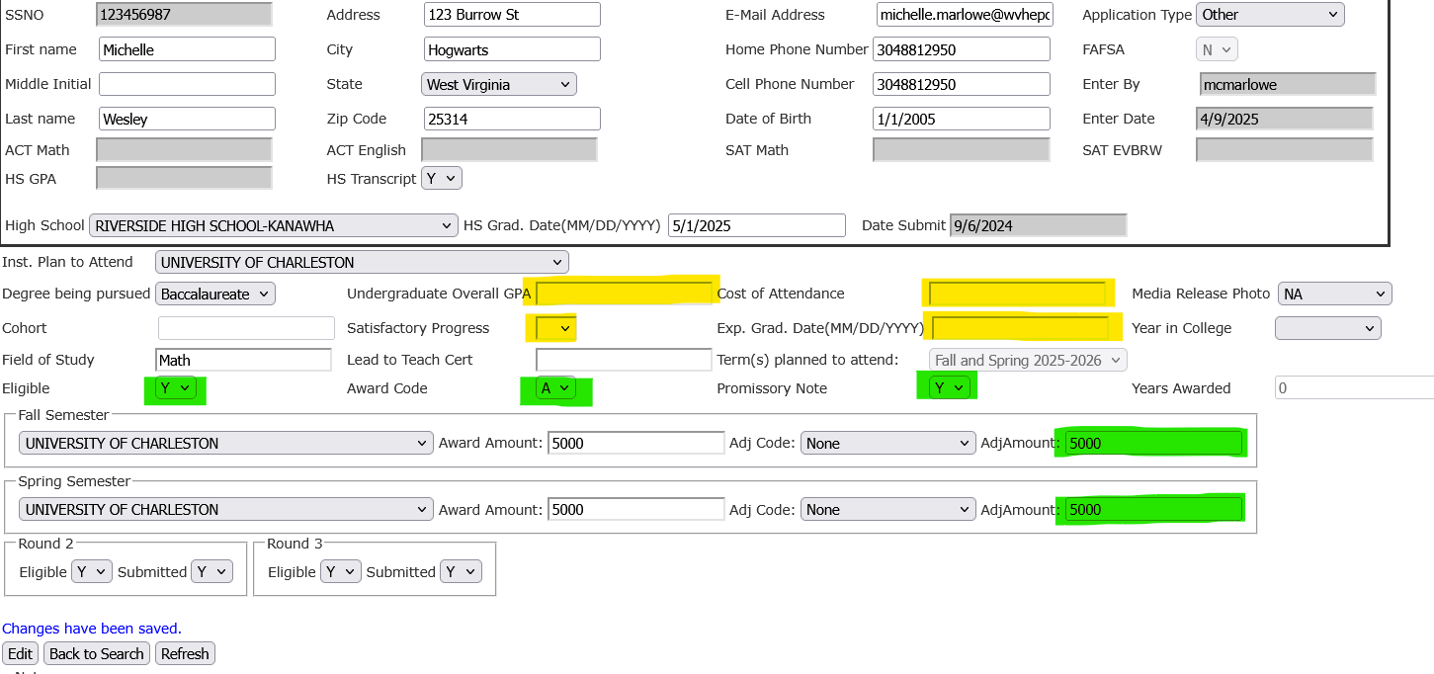

Green: eligible fields
Yellow: need updated

Slide 89
Questions?

Slide 90

Jordyn Reed, MPA
Director of Health Science Education Programs and Outreach
Health Sciences Division

Slide 91
Program Description
The West Virginia Nursing Scholarship Program is a scholarship program for students in nursing programs at the LPN, RN, and graduate levels. In exchange for accepting the scholarship award, recipients agree to complete service obligations in West Virginia after completing their programs OR repay the award back plus interest.

Slide 92
Eligibility Criteria
LPN and RN applicants must:
  Be enrolled at least part-time
  Be in good academic standing
  Meet a minimum cumulative and nursing GPA set after the award cycle closes.
  Pre-Licensure students must meet a nursing midpoint date (the date in which an applicant has completed at least 50% of their core nursing coursework, excluding pre and co-requisite courses).
  RN-BSN students starting this year are not required to complete a nursing midpoint date prior to award.
  LPN recipients must agree to complete a one-year service obligation in West Virginia, working full-time as an LPN OR repay the award.
  RN recipients must agree to complete a two-year service obligation in West Virginia, working full-time as an RN OR repay the award.

Slide 93
Eligibility Criteria
Graduate applicants must:
  Be enrolled at least part-time
  Be in good academic standing
  Meet a minimum GPA set after the award cycle closes
  Must be working as a nursing educator for a West Virginia school of nursing while accepting the award
  Must agree to the service obligation of working as a nursing educator in West Virginia after completing their program OR repay the award

Slide 94
Program Timeline
Applications are accepted through WVSAM April 15th through June 1st of each year.
After June 1st, we will reach out to financial aid contacts to supply the following information for applicants:
  Institutional graduation date
  Nursing midpoint date for LPN and RN applicants.
  GPAs for LPN and RN applicants who have already reached their nursing midpoint dates, RN-BSN applicants, and graduate applicants.
    Cumulative GPA
    Nursing GPA (only includes core nursing coursework, excluding any pre or co-requisite classes)
  Yearly cost of attendance

Slide 95
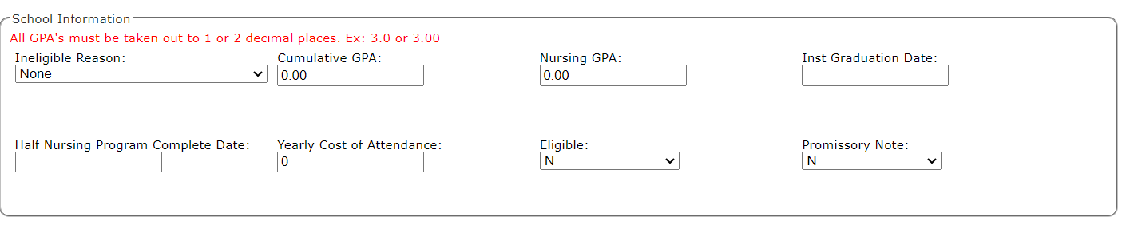
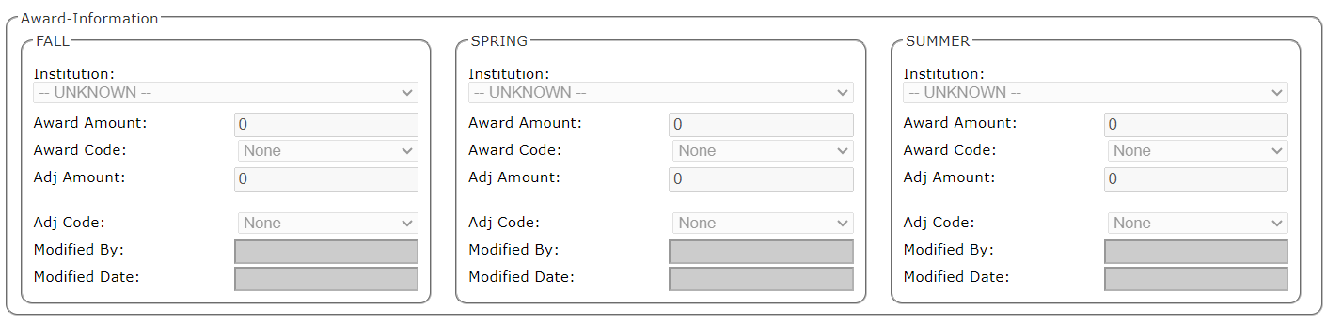
Updating FAMS

Slide 96
Program Timeline
Financial aid contacts have approximately 2 weeks to gather this information.
Once information is supplied, the GPA criteria and award amounts will be set and communicated to financial aid contacts.

Slide 97
Program Timeline
Applicants will then be notified of an award decision. There are three types of notifications:
  Awarded – will be sent an award letter and a promissory note to sign. Applicants must sign the promissory note within the required time-period or will forfeit the award. In FAMS, the following indicators in the eligibility fields and promissory note fields mean the following:
    Y in eligible field and P in prom note field for those who have been extended awards and are sent promissory notes.
    Y in eligible field and Y in prom note field for those who are both awarded and accept award.
    Y in eligible field and D in prom note field for those who were eligible but failed to sign promissory notes

Slide 98
Program Timeline
Applicants will then be notified of an award decision. There are three types of notifications:
  Denied – will be sent a denial email explaining the reason for denial. They will be told that if they think the decision was made on the incorrect information to reach out to their financial aid office to request a revision. In FAMS, the following indicators in the eligibility fields and promissory note fields mean the following:
    N in the eligible field and N in the promissory note field mean an applicant has been denied the award and is not eligible. An ineligible reason will be listed in the ineligible reason dropdown box.
  Will not reach midpoint until later – these applicants have not yet met the eligibility criteria but will do so later in the award year. They will be notified of this via email.
    P in the eligible field and N in the promissory note field mean that an applicant is not yet eligible for an award yet but will be evaluated once they reach their nursing midpoint date. Please provide updated GPA information on applicant’s midpoint dates so we can evaluate their eligibility for an award.

Slide 99
Program Timeline
Once the promissory note signing period has passed for applicants, FAMS will be updated to reflect this and you will be notified to check your FAMS roster for updates if changes are made.
Invoices will be generated and transmitted to you. You do not need to request invoices in FAMS, they will be automatically generated once promissory notes have been signed.
Throughout the award year, we will reach out to you about students who reach their nursing midpoint later on for you to supply updated GPA information. Once supplied, we will make additional awards and follow the same processes outlined above.

Slide 100
Adjustments for Withdrawals or Requests to Return Funds
If a student withdrawals from a nursing program and/or school – the award should be at a minimum adjusted proportionally.
Students who are withdrawing should be instructed that keeping any part of this award keeps them under the terms of the promissory note – if they are unable to fulfill the obligation, they will be required to repay the award.
If possible, we suggest a return of the full award to avoid being under the terms of the service obligation since students who do not complete their nursing program will be unable to fulfill the service obligation and will have to repay.
To adjust a student off, please ONLY adjust the “Award Adj” field under the corresponding term(s).

Slide 101
Closing Statements
At the end of the award year, you must review and request your closing statement in FAMS.
Please carefully review the amounts listed to make sure they match your records before requesting your closing statement.
If the amounts do not match, please email me at Jordyn.reed@wvhepc.edu.

Slide 102
Questions?

Slide 103


Slide 104

Block grant given to public 4-year, public 2-year, private non-profit, and career and vocational centers for their part-time students
  Possible option for students who are not eligible for WVHEG due to PT status.
Non-public college maximum award is the average credit hour rate at public institutions.
Maximum award is the cost of tuition and fees at public colleges.
March/April- Private Institutions and Vocational schools need to submit, by responding to the email request, Part-time enrollment numbers for allocation calculations.
Contact college/vocational school for application
Funds will be distributed to the institution directly – Annually in the fall.*
Notes:
*No additional funding available for HEAPS Part-time for 2025-2026

Slide 105
Eligibility for Traditional HEAPS
  Filed a FAFSA
  Demonstrate financial need
  Resident of WV at least 12 months before applying
  Not incarcerated in a correctional facility
  Enrolled part-time in a program of study that is less than graduate level toward a degree or certificate
  Taking 3 to 11 credits in the term
  At least a 2.0 gpa

Slide 106
Please be sure we have the correct contact information for your institution on the Closing [Search] menu in FAMS.
Awards for Traditional HEAPS - Each Institution is required to have their own policy and procedures
Annual Reports – email requesting this information is sent mid-May/early June.
  Submit via GoAnywhere
  Do not change the format – no additions to or removal of information
  If there is a delay in this report, there will be a delay in funds distribution.
  Whole dollar amount – No cents allowed

Slide 107


Slide 108

Application becomes available on July 1;
Application on WVSAM
Must file the FAFSA and complete HEAPS application – financial need
Can receive up to $2,000 for tuition and fees – for multiple programs
  Cannot be received for the same program twice
  Student can renew the grant for 4-years
For Certificate or short-term training programs like certified medical training, mining, gaming, LPN etc.

Slide 109
Eligibility for HEAPS Workforce
  Filed a FAFSA – Please advise the student to file the correct academic year FAFSA.
  Demonstrate financial need
  Resident of WV at least 12 months before applying
  Not incarcerated in a correctional facility
  Cannot be in default on a federal student loan

Slide 110
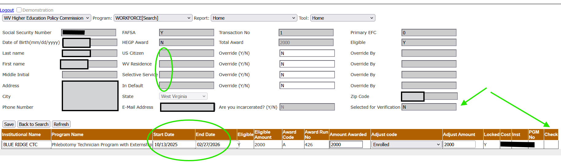
FAMS tips – Student info
-- Account Holds – Citizenship, Default, etc.
-- Dates – Double check the year
-- Verification – Institution must check the box for the student to be included on invoicing.

Slide 111
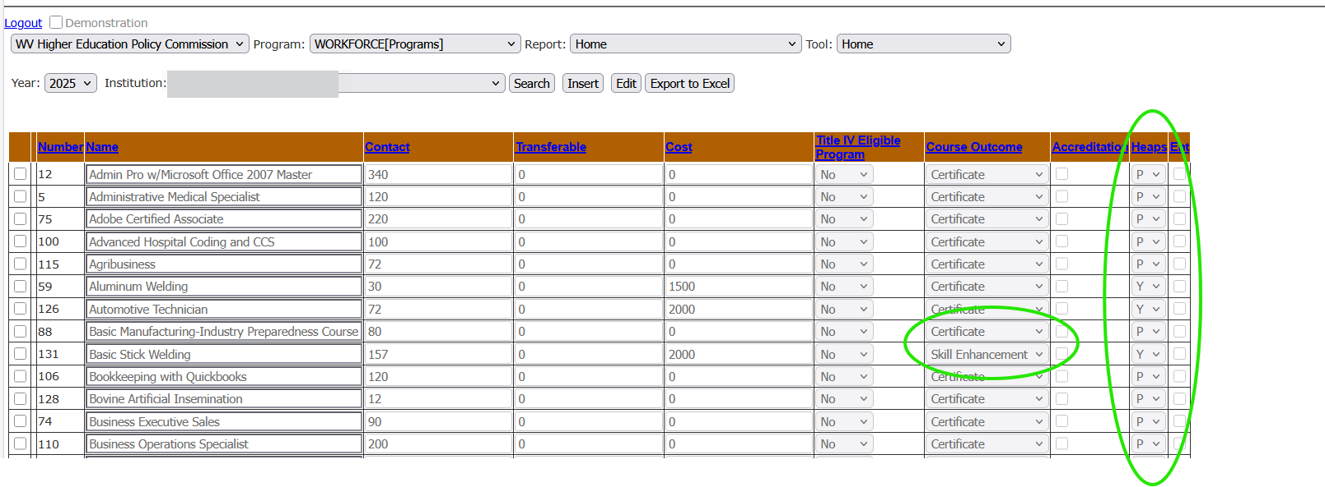

Slide 112
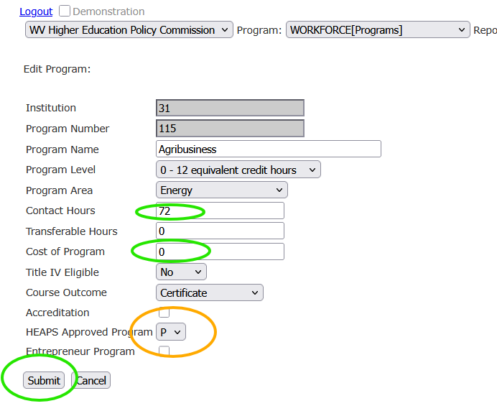
Programs –
  Programs are rolled over mid-June each year.
  Programs must be edited by the institution after rollover to be offered in the following academic year.
    Editing – Cost & Contact hours – Before July 1 to be sure the programs appear on the HEAPS Workforce application.
    New Programs – submit in May/June* for approval.
    DO NOT create a duplicate program
    Use consistent wording between the registrar and FAMS.
Notes:
*New Program submissions after July of the Academic year will be reviewed as time permits. We do not refuse new programs throughout the year, but approval is not prioritized.

Slide 113


Slide 114
Application open on a rolling basis as long as funds are available on a first-come, first-serve basis. No “deadline”
No FAFSA needed.
Students apply through their WVSAM account at www.cfwv.com
Students must currently in an eligible apprenticeship or have completed an eligible apprenticeship.
  HEPC will verify their apprenticeship
  Once apprenticeship is verified then institution would enter in the estimated award amounts for the terms
  STAND will cover tuition and any fees that are approved for WV Invests
  Fall – Summer terms for the award year
  Follow R2T4 policy if recipient withdraws from all courses similar to other state aid programs

Slide 115
STAND will cover up to 21 credits of general education of an associate of applied science or until requirements of associate degree are met
Recipients have a 6-year window to utilize STAND from when they first enroll
Must be WV residents
Apprenticeships are skilled trades registered and recognized by U.S. Department of Labor’s Office of Apprenticeship
Must maintain SAP to renew STAND Grant
Encourage your admissions office to reach out to those who apply for STAND so they know how to enroll at your institution

Slide 116
Questions?

Slide 117
BREAK
will resume at 10:50 am

Slide 118


Slide 119

Application
Complete WV Invests Grant application every year
  CFWV.com/WVInvests
  Applicate in WVSAM – must have or create account
  Opens October 1
  April 15 priority deadline
Complete the FAFSA every year
For SUMMER through SPRING
One application per year

Slide 120
Eligibility Criteria
Legal resident of West Virginia for 12 months before applying
Have a high school diploma or equivalent
Not be in default on a federal student loan
Be U.S. citizen or eligible non-citizen
Cannot already have a college degree (Associates or higher) or have attempted 90 or more credit hours
Be enrolled in an eligible major at a participating institution
Must maintain SAP
Renewal
All of the above
2.0 gpa

Slide 121
Awards
Last-dollar-in program
  Pays after certain other aid has been applied or calculated toward applicable charges
Pays toward tuition, mandatory fees, and approved academic program fees.
  Academic program fees coverage at CTCs started 2021-22
  Fees approved by WVCTCS
  Does not cover other non-approved fees, books, supplies, etc.
Because last-dollar, may be eligible but doesn’t have remaining charges Invests can pay toward.

Slide 122
Awards
Financial aid offices calculate award amounts
Tuition, mandatory fees and approved academic program fees
- Federal Grants (Pell, SEOG, other federal funded non-loan programs*)
- State financial aid eligible for (Promise, WV Higher Education Grant, HEAPS)
- Tuition waivers
= WV Invests Grant award amount (no cents – round down)
*Effective 2022-23 (summer 2022) expanded federal beyond Pell and SEOG

Slide 123
Report in FAMS
WIN[WIN_Promise_Award_HEPG_Elig]
  Identifies applicants eligible for WVHEG or has ever been awarded for Promise
    Shows applicants that are on your WVHEG and Promise rosters but also those that are not on your roster
  Lists by FAFSA year which matches application year for WV Invests
  Should always review when reconciling for the term and review prior to closing

Slide 124

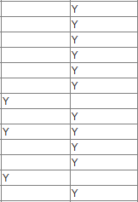

Slide 125
Student Requirements, if eligible
Enroll at least half-time
Pay for and take a drug screen during 60 days prior to first term eligible in each academic year through approved process
Complete a Promissory Note each year
Complete 2 hours of community service during each term in which funding is received as approved by the college
Must live in WV for 2 years or must pay back the funds after dropping below half-time enrollment

Slide 126
Appeals
Appeal to Waive Half-time Enrollment Requirement
  For students who do not have enough DPC to be half-time
  www.cfwv.com/investsappeal
Residency Appeals for State Financial Aid Eligibility
  www.cfwv.com/residency
  Not A WV Resident – NOT always indicator of residency status
    Incomplete FAFSA
    Indicated special circumstances
    Marked wants unsub loan only

Slide 127
Drug Screens
May only by required to take 1 drug screen each academic year before eligible term if passes and enrolls
If does not pass, can receive award first time but will have to take another drug screen during 60 days before next eligible term in academic year
If does not pass next screen 2nd time, must complete rehabilitation program prescribed by vice chancellor before being able to receive funds
After summer and fall reconciliation, passing results will be rolled into future terms in FAMS if: eligible, passed drug screen, and enrolled
  Will notify students if prior results qualified for future term

Slide 128
Drug Screens
Student must have/create an account at participateinprogram.com using WVSAM ID listed in Award Letter or in WVSAM Account
  Format: STU-######
  If already has account, may need to update old WV Invests Grant ID in account to WVSAM ID
Pays for drug screen then searches for closest approved testing site (make appointment or may accept walk-ins)
Must have driver's license or government-issued photo ID
10-panel urine screen
Current Cost $45.54 through May 31, 2026; cost will increase to $47.81 June 1, 2026. Cost changes annually, and paid by credit or debit card.
Results sent directly to WV Invests Grant program, but student can see results in account.

Slide 129
Drug Screen Appeals
Appealing results
Submit appeal to WV Invests
Out of pocket cost $175 to student to have sample re-tested

Slide 130
Drug Screens
Hard deadline in law – before term start date as provided by institution
Certify early so student notified with plenty of time to take drug screen.
Instructions are readily available at cfwv.com/wvinvests
  Includes line about not taking it before know if eligible
Letting a student know they can take the drug screen before being certifying should be case-by-case only. Student needs to be told and understand:
  Taking drug screen does not guarantee they will be eligible but buys them time so application can be reviewed after classes start.
  Not telling them to take the drug screen but giving option for them to decide.

Slide 131
Promissory Note
Must complete annually for entire academic year
Electronically sent to student via webmaster@ecsi.net after drug screen results received and processed
Agrees to live is WV for 2 years after dropping below half time
Outlines terms if grant converts to a loan
Email reminders sent with deadline, extended deadline before canceled

Slide 132
Community Service
2 hours required every term receiving award
Must complete during term – day 1 through end of term
Documentation submitted and approved by college
  College reports completion on FAMS for each term
Cannot be for:
  Family member
  Pay
  Proselytizing
Failure to complete during term results in loss of award for term

Slide 133
Process
Student applies and completes FAFSA
College FA offices certify application as eligible or ineligible
  For eligible applicants, certification begins in March for Summer-Spring, June for Fall-Spring, November for Spring only.
  If ineligible and student resolves reason, application can/should be reviewed and certified again by college.
Student receives communications (award letter or denial letter based on certification and certification date) - sent daily most of year NEXT business day
  If student is eligible, next steps listed in award letter
Drug screen results and promissory notes processed daily to FAMS day after received

Slide 134
Common Mistake/Issues on Application
No FAFSA but school has complete FAFSA. Check SSN and DOB on FAMS
  If incorrect in FAMS, student must update their Contact Information in WVSAM
  If incorrect on FAFSA, student must correct FAFSA
Not a WV Resident but is a resident
  Is FAFSA incomplete? This is default reason for null FAFSA
  Has the student indicated they want unsub loan only?
  Is state residence question answered and date listed on FAFSA? (also for parent of dependent student)
    Appeal option

Slide 135

You can change as eligiblity changes
FAMS – Institution Eligibility
FAMS Driven (can’t select)
No FAFSA - F
Has a prior degree - A
Not a WV resident - AF
Not in eligible program - A
No high school degree - F
Defaulted on student loan - F
Not a citizen or legal resident - F
School selects
Eligible
Eligible but has enough aid
No information on file
Not meeting SAP
Not eligible by Institution
Eligible but declined award
Verification
90+ hours/Associate Degree
Only Certify Ineligible
A = determined from application
F = determined from FAFSA
Notes:
Let’s talk through some of these Inst Eligiblity codes and how or why they present in FAMS.
Everything in the left column is driven by FAMS and cannot be changed by you. These are determined by either what’s on the application, what’s on the FAFSA, or both. An A means if comes from the application and F means the FAFSA. Anyone with these reasons cannot be certified as Eligible but can be certified as ineligible, for that reason only. Some of the odd things
If you see No FAFSA and your office has the FAFSA, check the student’s SSN, DOB and name on the application (and FAFSA but usually it’s an error on the WIN app). Also, if you see the Transaction Number, FAF Number and Primary SAI fields in FAMS are blank and you have the FAFSA – most likely DOB and maybe name.
Has a prior degree and Not in eligible program are based on responses on the application. If the application is incorrect, you can correct the Education Level, Academic Level or Academic Program fields – in either direction to fix them to eligible or ineligible for those reasons. If a student indicates Academic Program is Other, they must also have something in Program Other field. Other automatically triggers Not In Eligible Program. Also, if they list an eligible program but they aren’t admitted in that program, you can change it to the correct program or if they aren’t admitted into an eligible program, you can change it to Other and type in the actual major in Program Other field so FAMS will update to Not In Eligible Program as denial reason.
Not a WV resident is a fun one. Yes, this means they weren’t a resident for at least 12 months as of the date they applied. If they have been a WV resident,
this could mean they made a mistake on the application (specifically state in the address) or
probably didn’t answer the what date they became a resident on the FAFSA (for themselves and parents if dependent because, like all state programs, residency is based on the residency of the parent for dependent students) or
the parent is a resident of a different state; in this case, if the student has been living in WV, have them contact me.
The most fun reason this populates is the student’s FAFSA is incomplete and/or missing parental information so FAMS can’t determine if they are dependent or independent to determine residency and it defaults to this. You’re likely to also see a Primary SAI of 999998 for these. This is what FAMS creates for a null ISIR.
No high school degree is determined from the FAFSA. If they made an error, they need to correct the FAFSA and, once we pull the corrected FAFSA into our system, FAMS will update.
Defaulted and citizen are based cflags from the FAFSA. If you collect documentation to clear the flag in your office, reach out to me because we must similarly override the cflag. If we get a FAFSA without the flag, FAMS will update.
The right column are things, if you see them, you can change them. These are denial reasons you select.
If it shows Eligible, then the student cleared the left side list and appears eligible but still needs reviewed for anything on the right-hand list at your school to determine if they are ineligible. If was ineligible for anything on left side, certified or not, and it’s corrected, Eligible will populate until certified again.
You can certify someone as ineligible then later certify them as eligible if eligibility changes… as long as FAMS does not show a reason in the left side column. So technically FAMS will let you change it but, when you hit save or certify, it will revert back. If it was ineligible for a reason on the right-hand side, you can change them from ineligible to eligible or ineligible for a different reason.

Slide 136
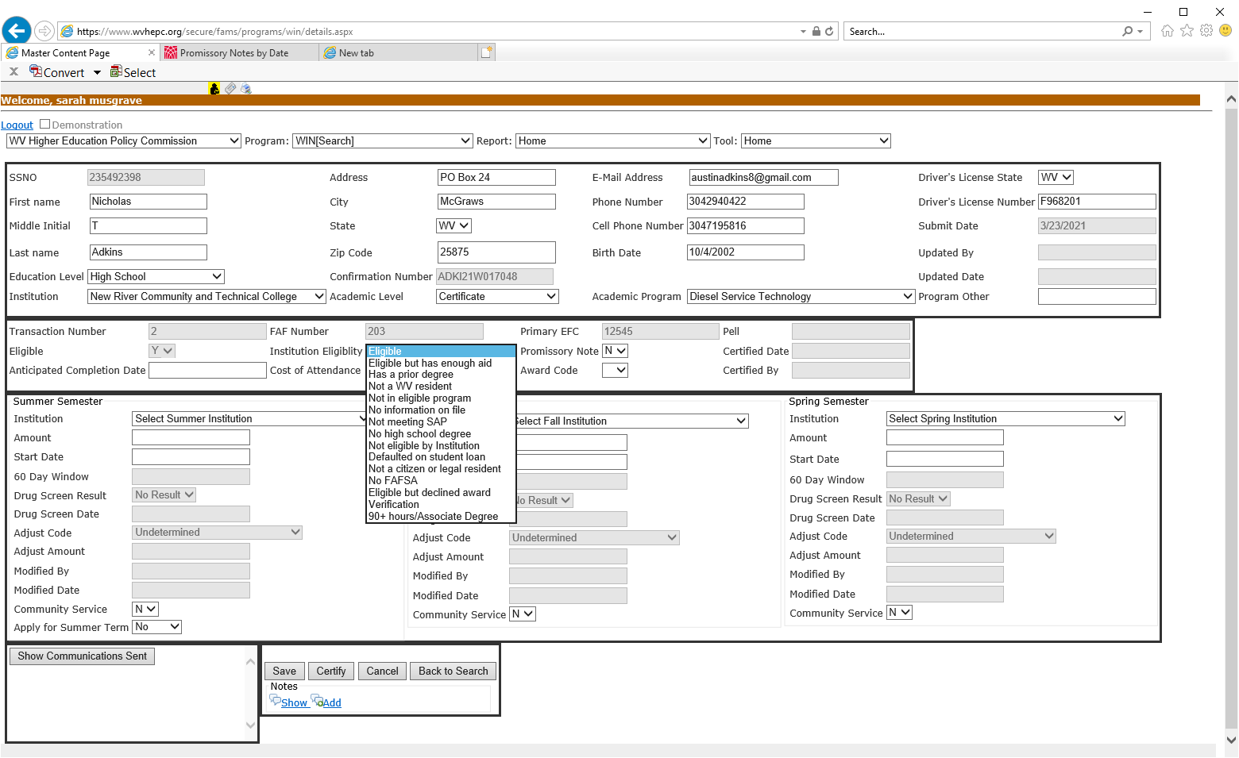
Certifying
Eligible field
N = Ineligible
  Initial review – can only certify as ineligible
  Subsequent review after certified – depends
Y = Appears eligible in FAMS but school must still review eligiblity.

Slide 137
- Eligible gets Award Letter email/text.
- Eligible But Declined Award gets nothing.
- All others get denial email/ text with reason ineligible.
Award Code must be P or D to get communication
- P = Award Letter
- D = Denial

Slide 138
Certify Eligible
Fields to complete
  Anticipated Completion Date
  Cost of Attendance
  In each Semester box eligible
    Amount
    Start Date (will calculate 60 Day Window)
  Double check dates
Hit Certify. This will:
  change Award Code to P
  populate or update Certified Date and Certified By fields

Slide 139
Certify Ineligible
Fields to update
  Institutional Eligibility – unless already reflecting the ineligible reason
Hit Certify. This will:
  change Award Code to D
  populate or update Certified Date and Certified By fields
USE our denial notification to help get students to complete requirements earlier
  No FAFSA
  Verification
  Not meeting SAP

Slide 140
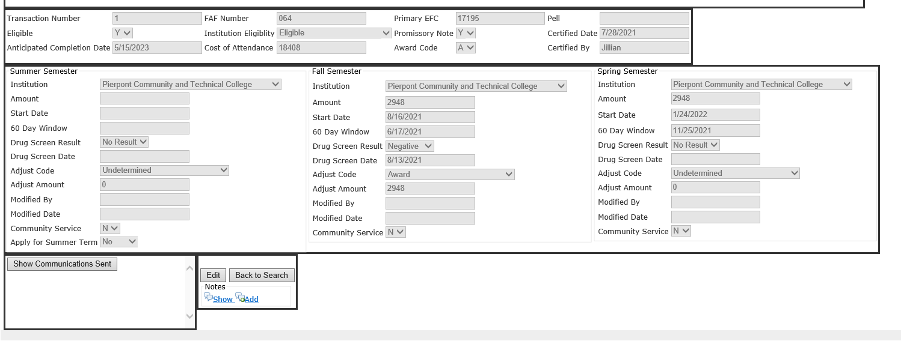
Drug Screen Complete:
When something other than No Result shows.
If no Drug Screen Date, results were rolled from previous term.
Promissory Note Complete:
When Y.
N = still no results
P = generated but unsigned
D = canceled.
Award Code updates to A, Adjust Code to Award, and Adjust Amount populated after Drug Screen and Prom Note complete each term.
Where to indicate Community Service has been completed

Slide 141
Community Service Processing
Completed and approved
  Change Community Service for term to Y
If does not complete
  Cancel award at school and student owes back to school
  Update Adjust Code to Did Not Complete Comm Service
  Update Adjust Amount to $0

Slide 142
Communication Codes (2025-2026)
Show Communications Sent box
WIN25Award = award letter
WIN25Denial = denial notification
WIN25DsRmdSu = summer drug screen reminder notification
  WIN25DsRmdFa (fall), WIN25DsRmdSp (spring)
WIN25PnRmd = promissory note reminder
WIN25CsRmdSu = summer community reminder notification
  WIN25CsRmdFa (fall), WIN25CsRmdSp (spring)
WIN25Roll = prior drug screen results rolled to future term and doesn’t need taken again

Slide 143
Exit
Once student graduates (not cont. toward Assoc.) or drops below half-time enrollment (does not re-enroll), must complete Exit Interview
Schools provide separation date to WV Invests via GoAnywhere
  SSN, student last name, student first name, separation date
    Summer enrollment not included, generally; do need summer graduates
  Frequency – at end of term and after term begins, at least (fall/spring)
  Email program manager when loaded
Student sent email with link to Exit Interview to complete
Reminds student of their obligation, collects updated contact information

Slide 144
Post-Enrollment Residency Obligation
Only agreeing to live is WV; does NOT have to work in WV or in field
Begins after no longer enrolled at least part time (at any school)
  First enters 6-month grace period
We will contact student for documentation, when needed
Residency verified 3 times during 2 years
If student gets a bill from Heartland ECSI, contact WV Invests
  wvinvests@wvctcs.edu or 304-558-4618

Slide 145
Questions?

Slide 146

Division of Financial Aid
West Virginia Higher Education Policy Commission
(304) 558-4618 • wvfinancialaid@wvhepc.edu
www.wvhepc.edu

